Slide 1

Song presentation
Author: Lawrence Wu

Slide 2
Pewdiepie v.s. T-Series
***** Lasagna
Sanitized for English presentation
https://www.youtube.com/watch?v=aMXMTE9_3Vs

Slide 3
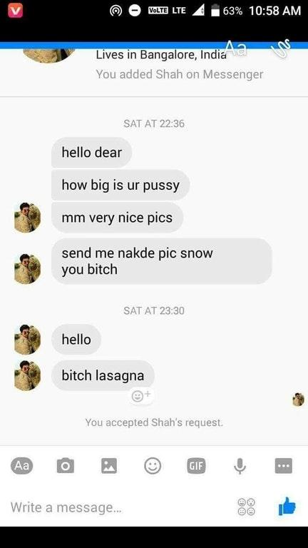
Song name
Pewdiepie is a male
Received harassment message

Slide 4
Pewdiepie v.s. T-Series
Pewdiepie
T-Series
Swedish American
#2 Youtuber
1B+ Subscribers
1.5% of global population
Indian Corporation
#1 Youtuber
1/5 of national population

Slide 5


Pewdiepie v.s. T-Series
Pewdiepie
T-Series
Blue eye dragon
Dark magician

Slide 6
Explanations
Pewdiepie call his audiences Bobs
Spill the tea
Spill out his scandals
Dethrone
Get rid of pewdiepie's #1 throne

Slide 7
Explanations
Sub bot
Subscriber bots
9-year-old
Most of pew's fan are kids

Slide 8
Q&A

